Slide 1

Year 10 Work Experience Celebration

Slide 2

Student Spotlight

Slide 3

Student Spotlight 1
Joel – City Holdings
Punctuality and reliability
Excellent
Overall attitude
Excellent
Communication
Excellent
Problem solving
Excellent
Teamwork
Excellent
Independence
Excellent

Slide 4

Student Spotlight 2
Jake – Jill Clewes Academy
Punctuality and reliability
Excellent
Overall attitude
Excellent
Communication
Excellent
Problem solving
Excellent
Teamwork
Excellent
Independence
Excellent

Slide 5

Student Spotlight 3
Benji – Sea & Earth
Punctuality and reliability
Excellent
Overall attitude
Excellent
Communication
Excellent
Problem solving
Excellent
Teamwork
Excellent
Independence
Excellent

Slide 6

Student Spotlight 4
Oliver – BAE Systems
Punctuality and reliability
Excellent
Overall attitude
Excellent
Communication
Excellent
Problem solving
Excellent
Teamwork
Excellent
Independence
Excellent

Slide 7

Student Spotlight 5
Carter – LTH Plumbing & Heating
Punctuality and reliability
Excellent
Overall attitude
Excellent
Communication
Excellent
Problem solving
Excellent
Teamwork
Excellent
Independence
Excellent

Slide 8

Student Spotlight 6
Aoife – CTD Architects
Punctuality and reliability
Excellent
Overall attitude
Excellent
Communication
Excellent
Problem solving
Excellent
Teamwork
Excellent
Independence
Excellent

Slide 9
Employer Feedback

Slide 10

Employer Feedback 1
Cole – Carpet Couture
Cole did everything that was asked of him we had him fetching stuff from the van ranging from gripper to underlay and Henry hoover and he was taught how to put gripper down properly and also cut in the underlay to the gripper.

Slide 11

Employer Feedback 2
Noah – GRC Retail Solutions
Noah was a real pleasure to have during the week, he was polite, respectful and a credit to the school.
His attitude during the week was supported by his hard work and willing to learn.

Slide 12

Employer Feedback 3
Kobi – Staffordshire Fire & Rescue
Kobi was very passionate about the equipment, and the placement was well suited to him with his desire to pursue engineering. He asked questions to better his understanding and was a clear communicator throughout the course of the placement. Kobi thoroughly enjoyed seeing the equipment at our Transport site and BAM.

Slide 13

Employer Feedback 4
Ella - Westwood Pre-School
“Ella has a natural ability with young children, and I think was surprised herself by how quickly she formed those special bonds. She did everything asked of her and more. Supporting staff with activities and joining in, carrying out a craft activity, making cakes, doing a gymnastics class, reading fairy class, the list goes on”.

Slide 14

Employer Feedback 5
Sam – Whittaker & Biggs
Samuel's strongest skill was his ability to learn quickly and take initiative. He showed this when completing new tasks independently after receiving initial guidance, demonstrating confidence, attention to detail, and a positive attitude throughout his placement.

Slide 15

Employer Feedback 6
Lollie – Kids Planet
Lollie worked in each room and made great relationships with the teams she worked with being very adaptable. She helped with tasks and at busier times of the day took the initiative to occupy children with singing and games.

Slide 16

Employer Feedback 7
Elouise – Lux Interior
Elouise was competent in interpreting the clients requirements into a working design showing that she had listened to and understood what was required.

Slide 17

Employer Feedback 8
Owen – Waterhouses Primary Academy
Owen was always keen to get involved and help in any way he could. He was dressed smartly and appropriately. He spoke politely and we enjoyed having his help
Owen was able to work independently - for example when helping out with sports day to get equipment ready. Very willing and eager to learn.
. Esme Aberley

Slide 18
Success Stories

Slide 19

Success Stories 1
Bella – Direct Part
Bella went to Direct Parts for her work experience, where she was described as an absolute delight to have as part of the team.
Throughout her placement, Bella went above and beyond to learn about the different aspects of engineering and explore the various ways these skills can be applied within the motorsport industry. Her enthusiasm, curiosity and willingness to learn made a fantastic impression on everyone she worked with.

Slide 20

Success Stories 2
Jacob – F-Ball
Jacob went to F-Ball for his work experience, where he was able to demonstrate a range of different skills and positive attributes throughout his placement.
He made a fantastic impression on the team and was described as a lovely, polite young man.

Slide 21

Success Stories 3
Jack – Peak Fitness
Jack went to Peak Fitness for his work experience, where he had the opportunity to work directly with clients and put his skills into practice.
Sam made such a positive impression and was so successful during his placement that he has now been offered part-time hours at the weekend!
This is an amazing achievement and a fantastic example of how work experience can lead to real employment opportunities.

Slide 22

Success Stories 4
Peter, Natalie, Priya – Leek Radio
Peter, Natalie and Priya went to Leek Radio for their work experience. At the start, they were saying they wouldn’t go on the radio, but by the end of the week they had produced three brilliant radio shows!
It was a real joy listening to them all talking live on air, sharing their jokes, playing different styles of music and, of course, hearing Pete’s singing! It was fantastic to see their confidence grow throughout the experience and to hear them enjoying themselves so much on the radio.

Slide 23

Success Stories 4
Kyala & Grace– Zoomies
Kayla and Grace went to Zoomies for their work experience, where they both showed a genuine interest in the industry.
Throughout their placement, they asked the right questions and took the opportunity to learn more about the different roles and opportunities available. Their enthusiasm and curiosity helped them gain valuable knowledge that will support them in making informed decisions about their next steps.

Slide 24

Success Stories 4
Cerys – Westwood Pre-School
Cerys went to Westwood Pre-School for her work experience, where her dedication and hard work throughout the week made a fantastic impression on the whole team.
In the words of the manager, “Can we keep her?” this truly reflects the commitment, enthusiasm and positive attitude Cerys demonstrated throughout the week.

Slide 25

Success Stories 4
Ashton –Port Vale FC
Ashton went to Port Vale for his work experience and got stuck in from the moment he stepped through the door.
His enthusiasm, hard work and willingness to get involved made an incredible impression on the team. By the end of his placement, Ashton was told that he was the best work experience student they had had for years and that he would go far in this environment.

Slide 26

Success Stories 4
Joel - David Smith Funeral Directors
Joel went to David Smith Funeral Directors for his work experience, where he was described as an absolute credit to both himself and Westwood College.
His attitude towards work and learning went above and beyond expectations, and he approached every opportunity with maturity, respect and a willingness to learn. Joel was described as an absolute delight to have working with the team,

Slide 27
Photo Montage

Slide 28
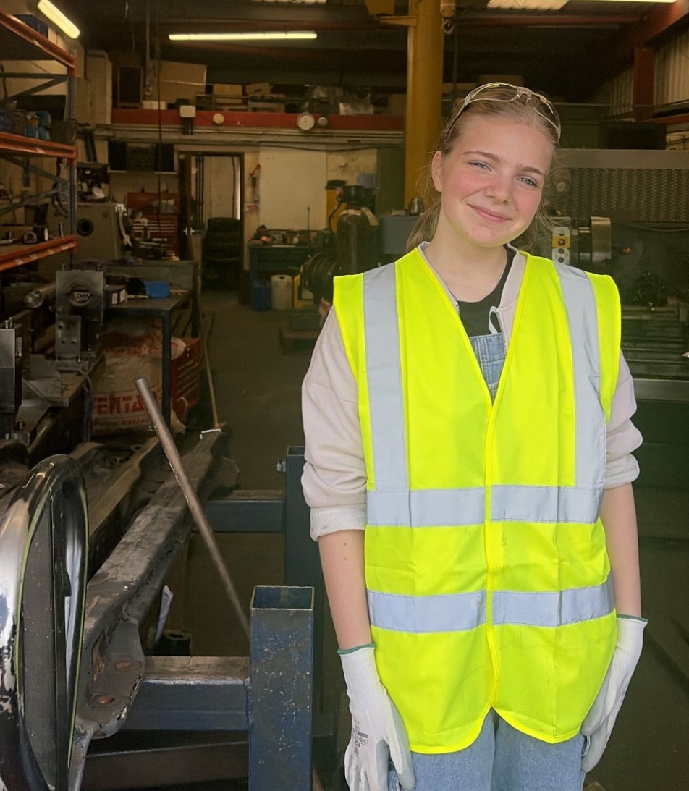
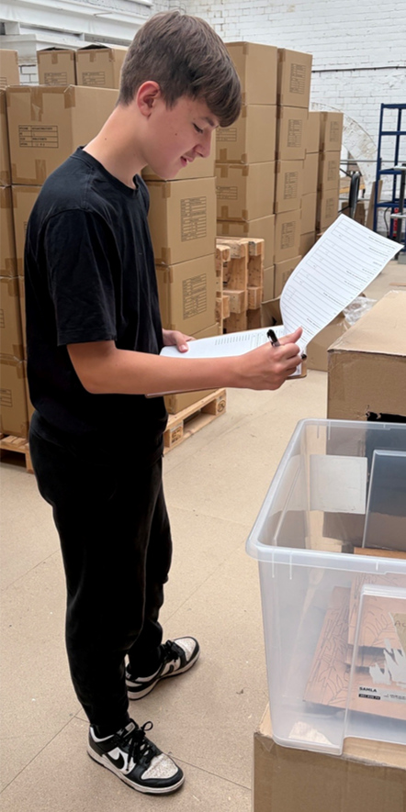
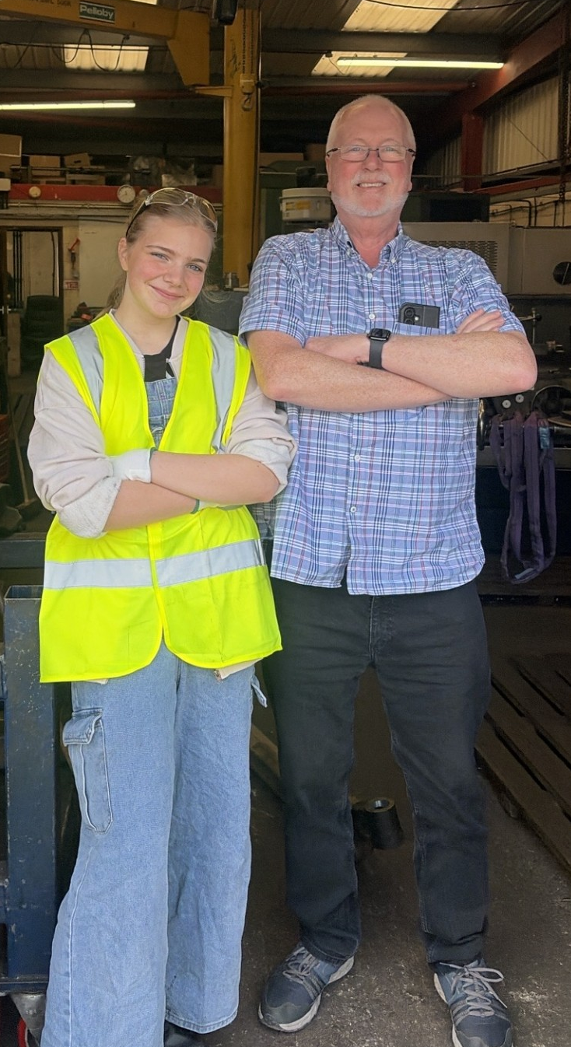
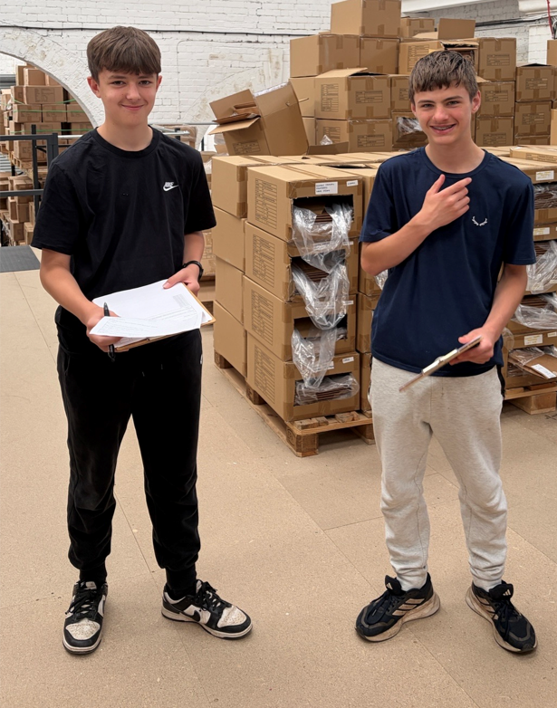
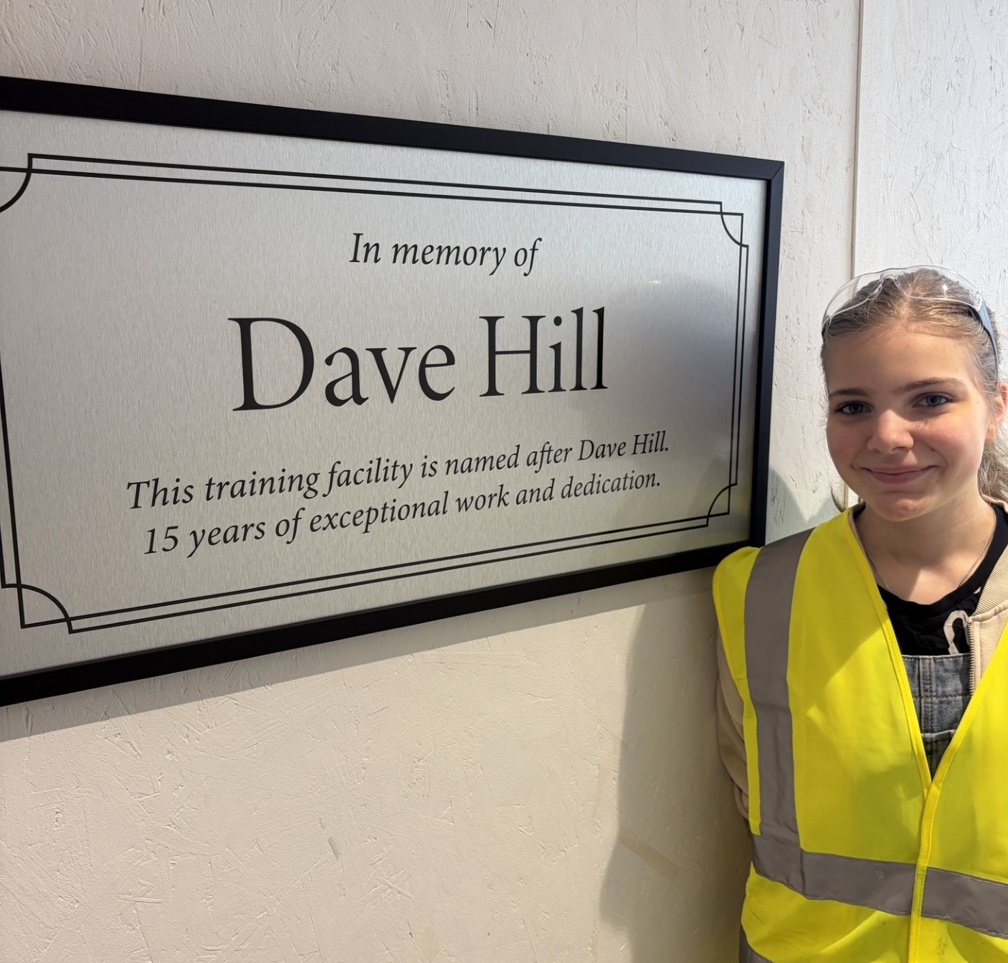
Photo Montage

Slide 29
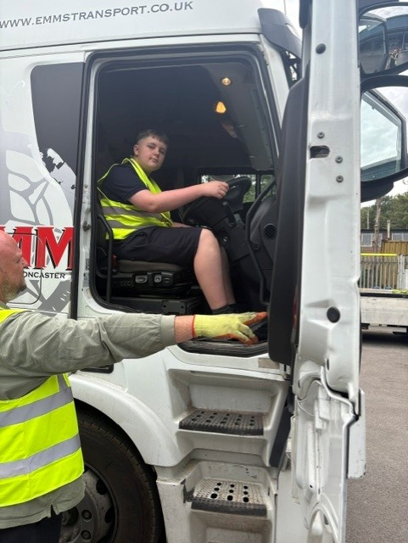
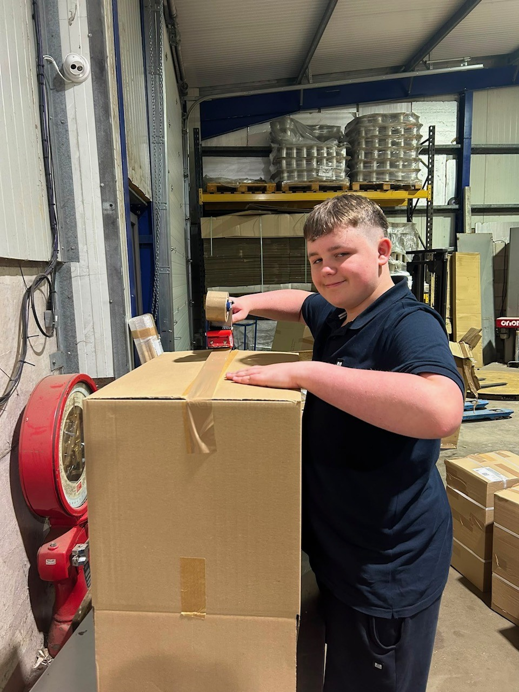
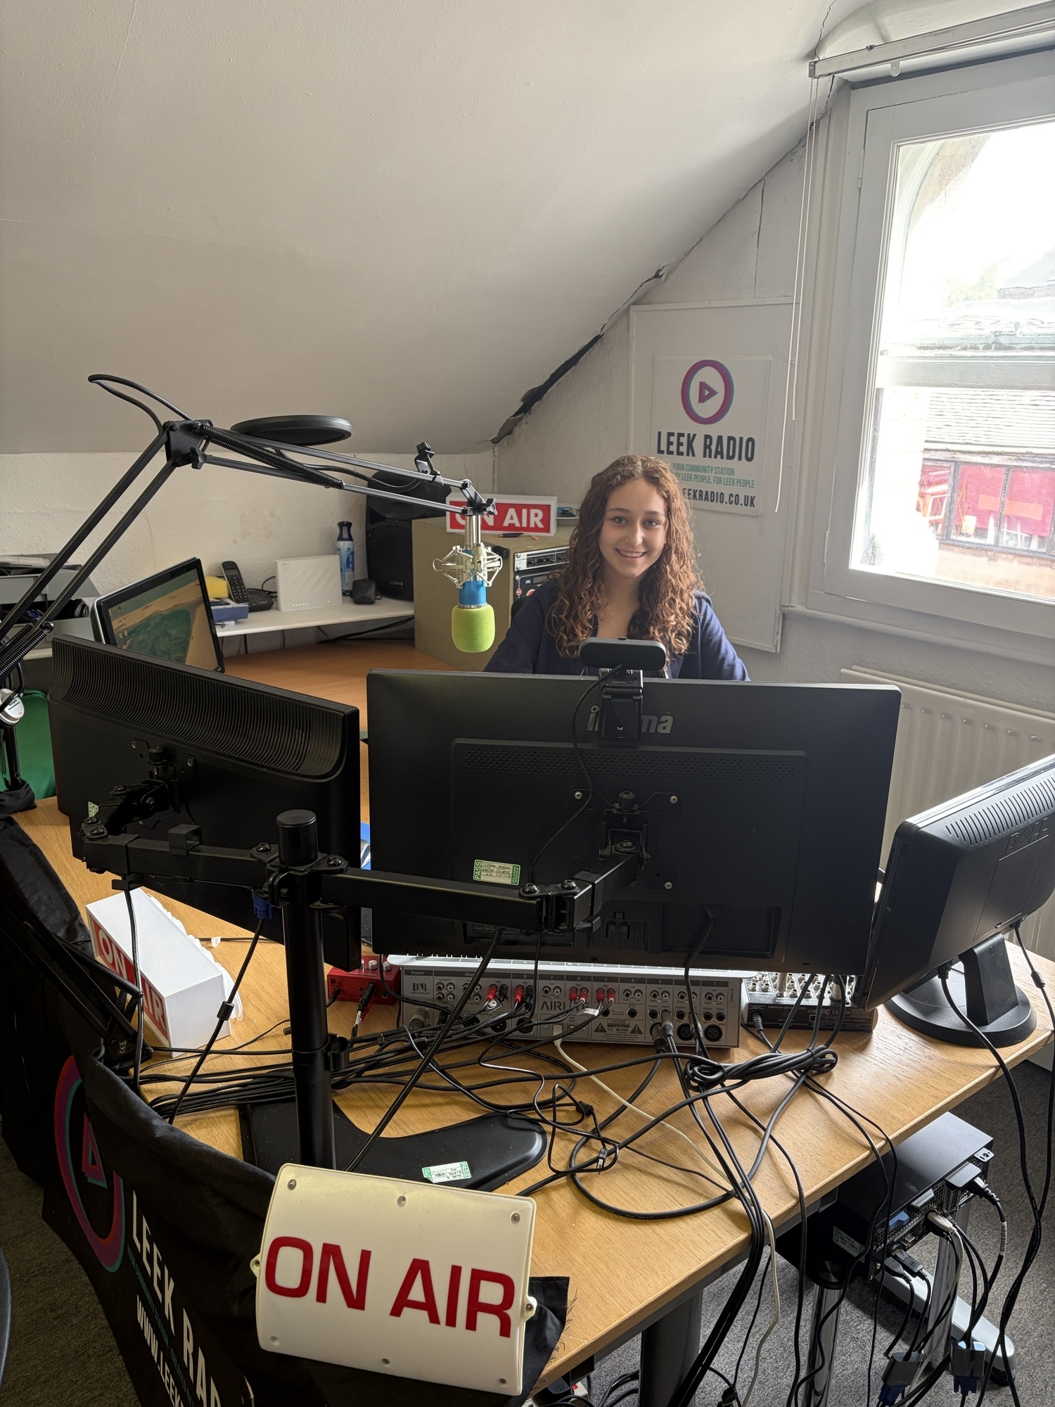
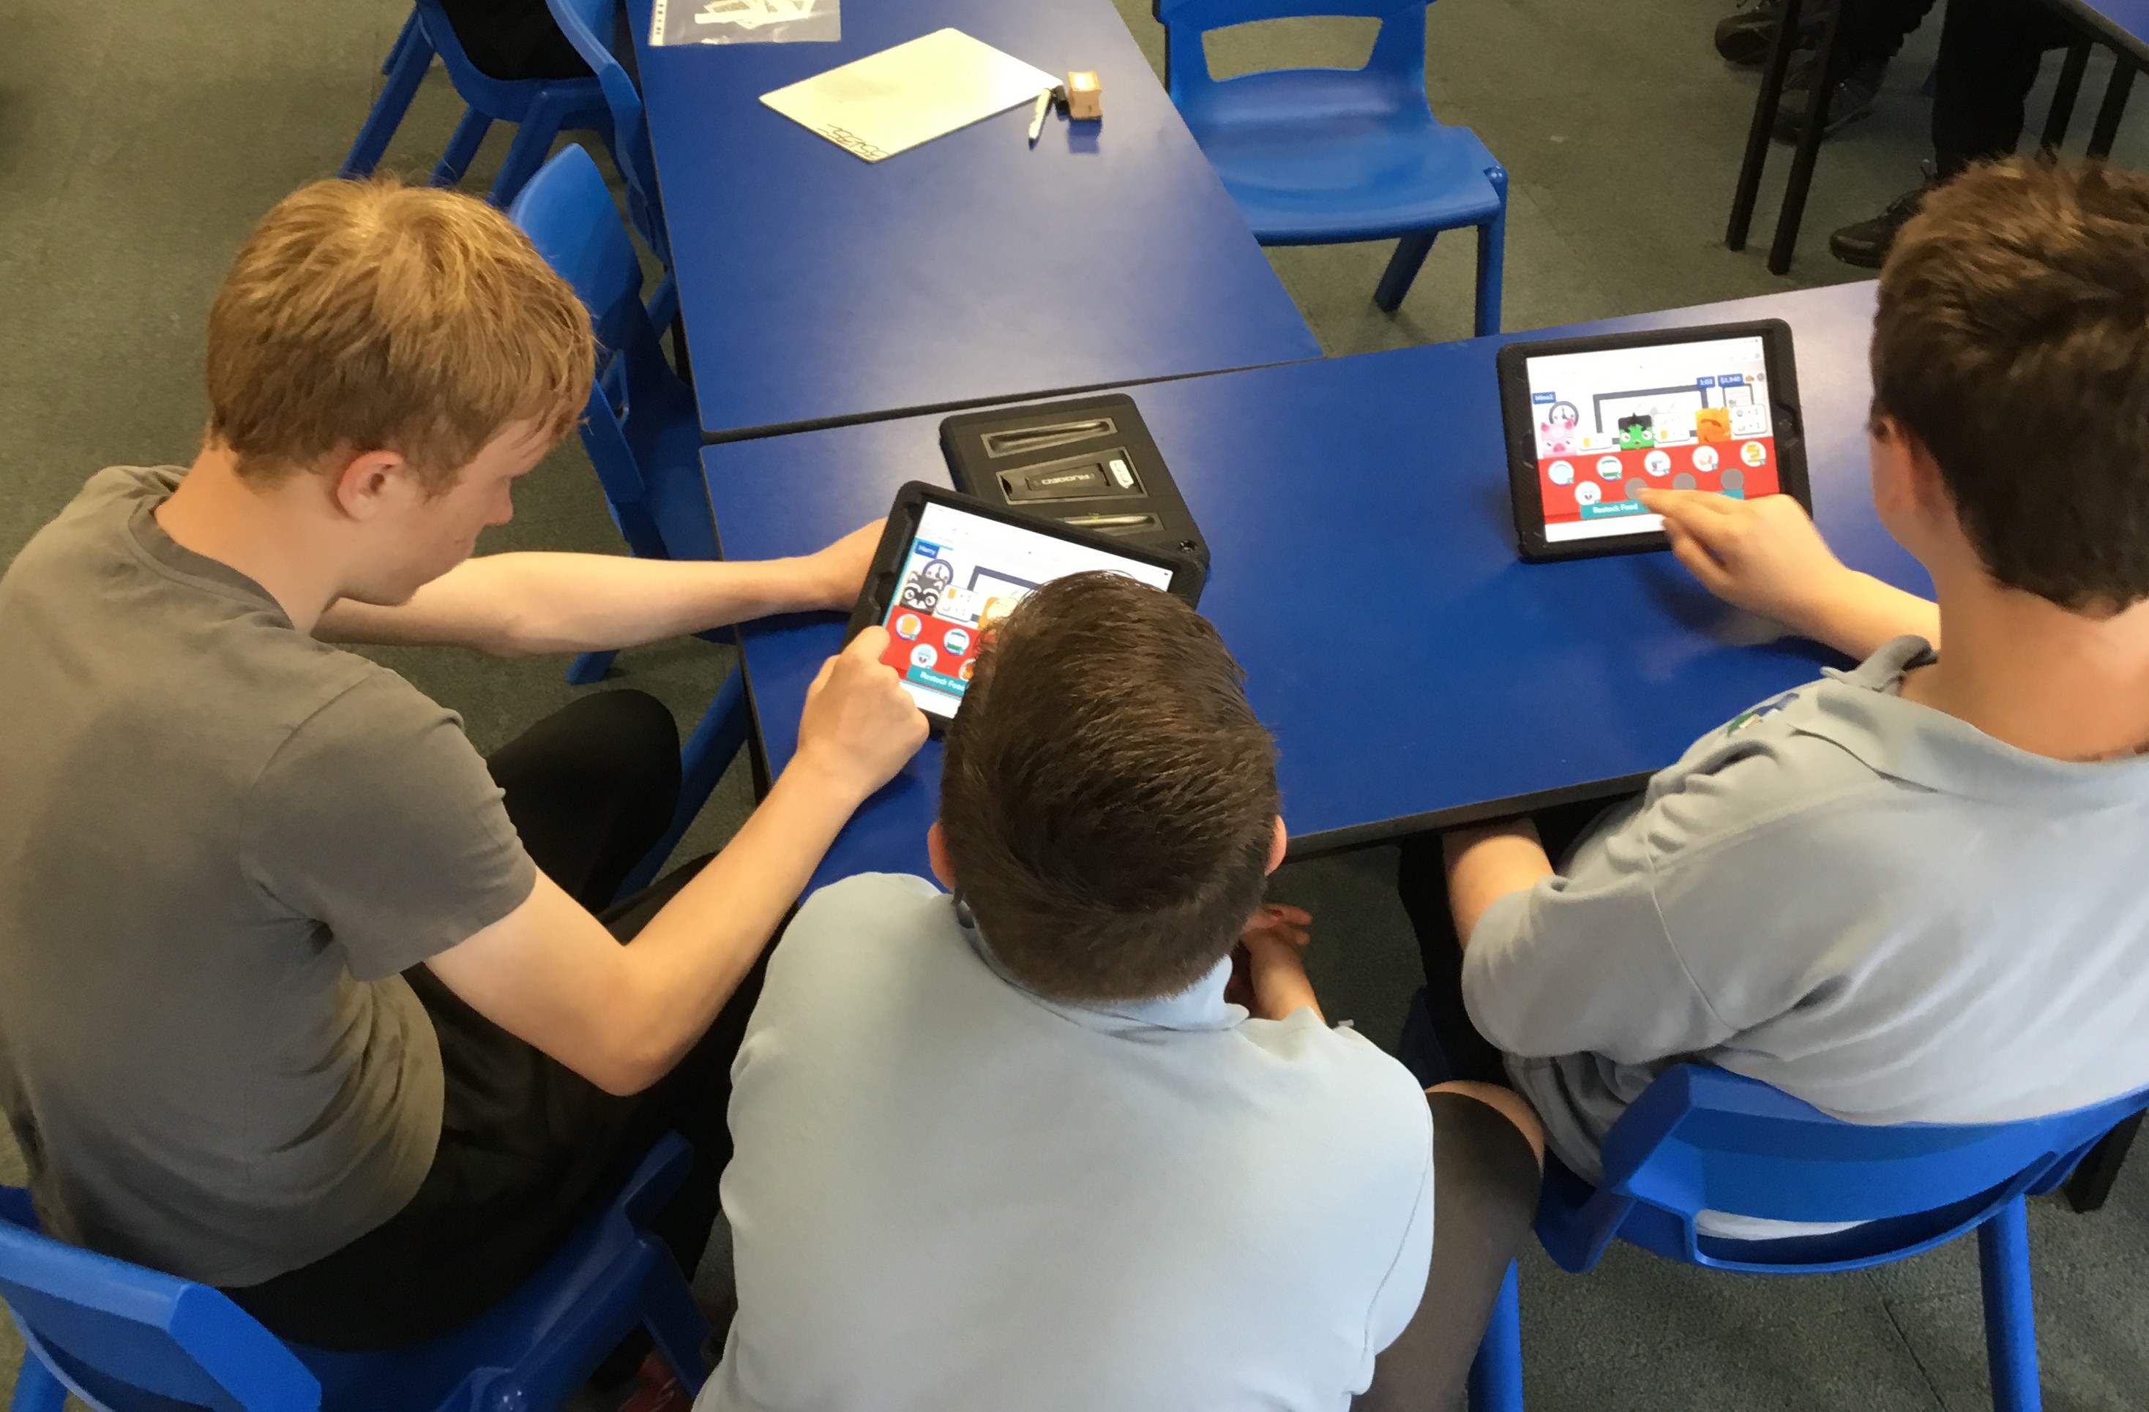
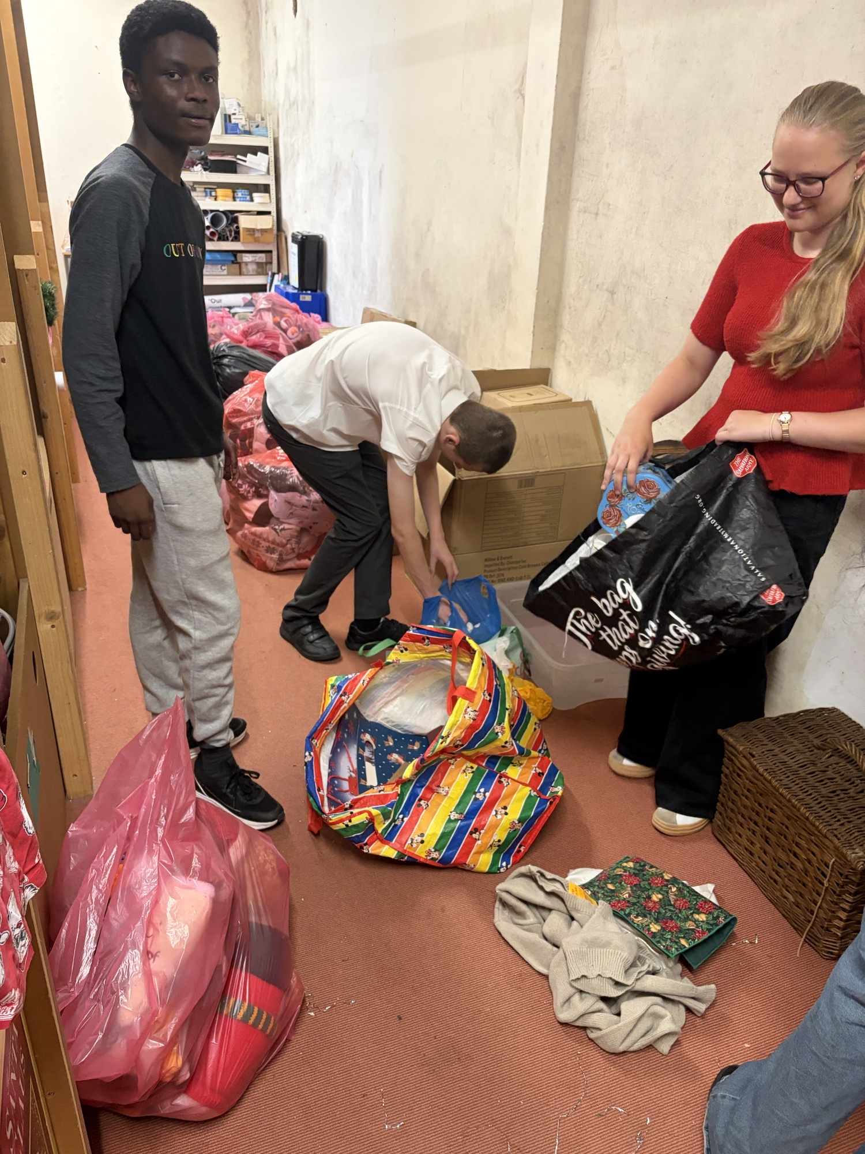
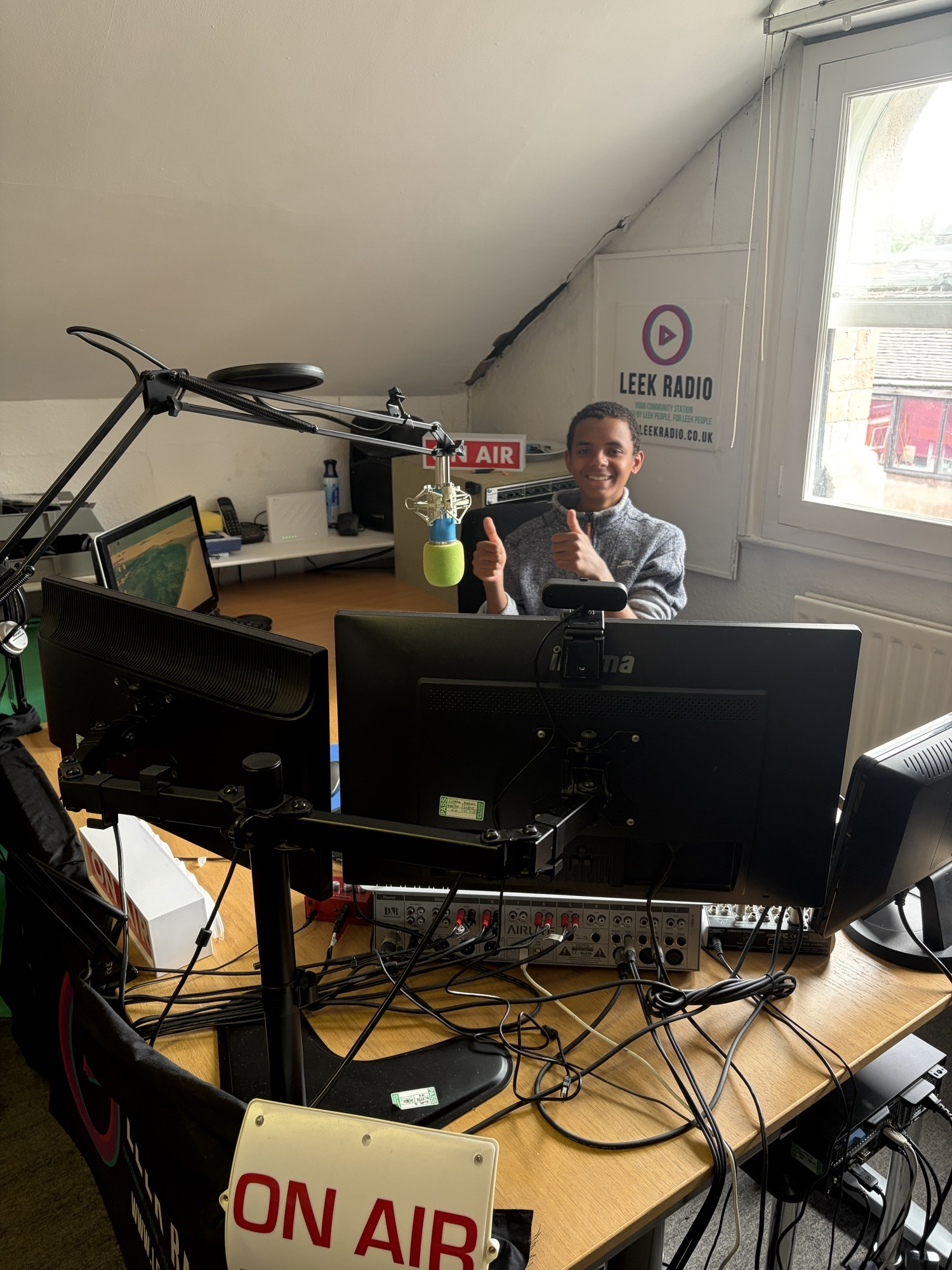
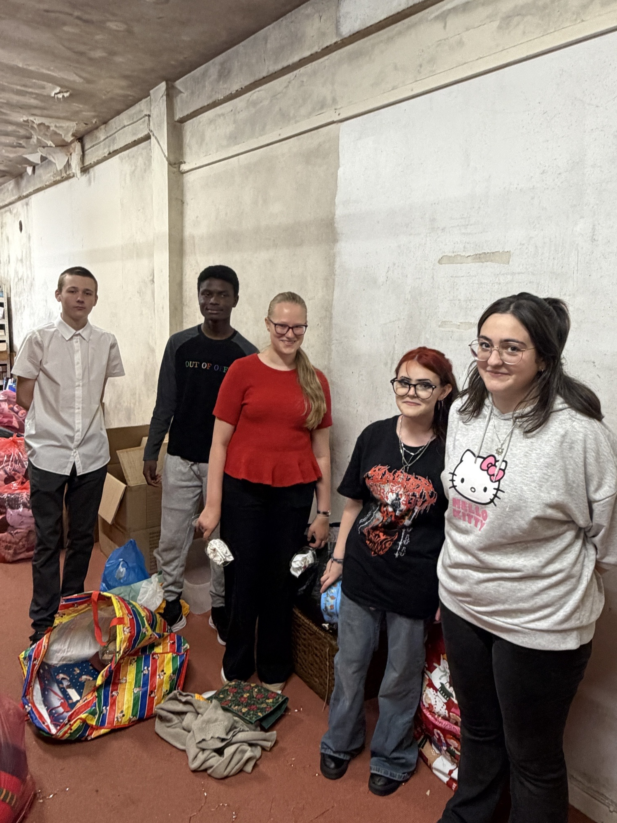
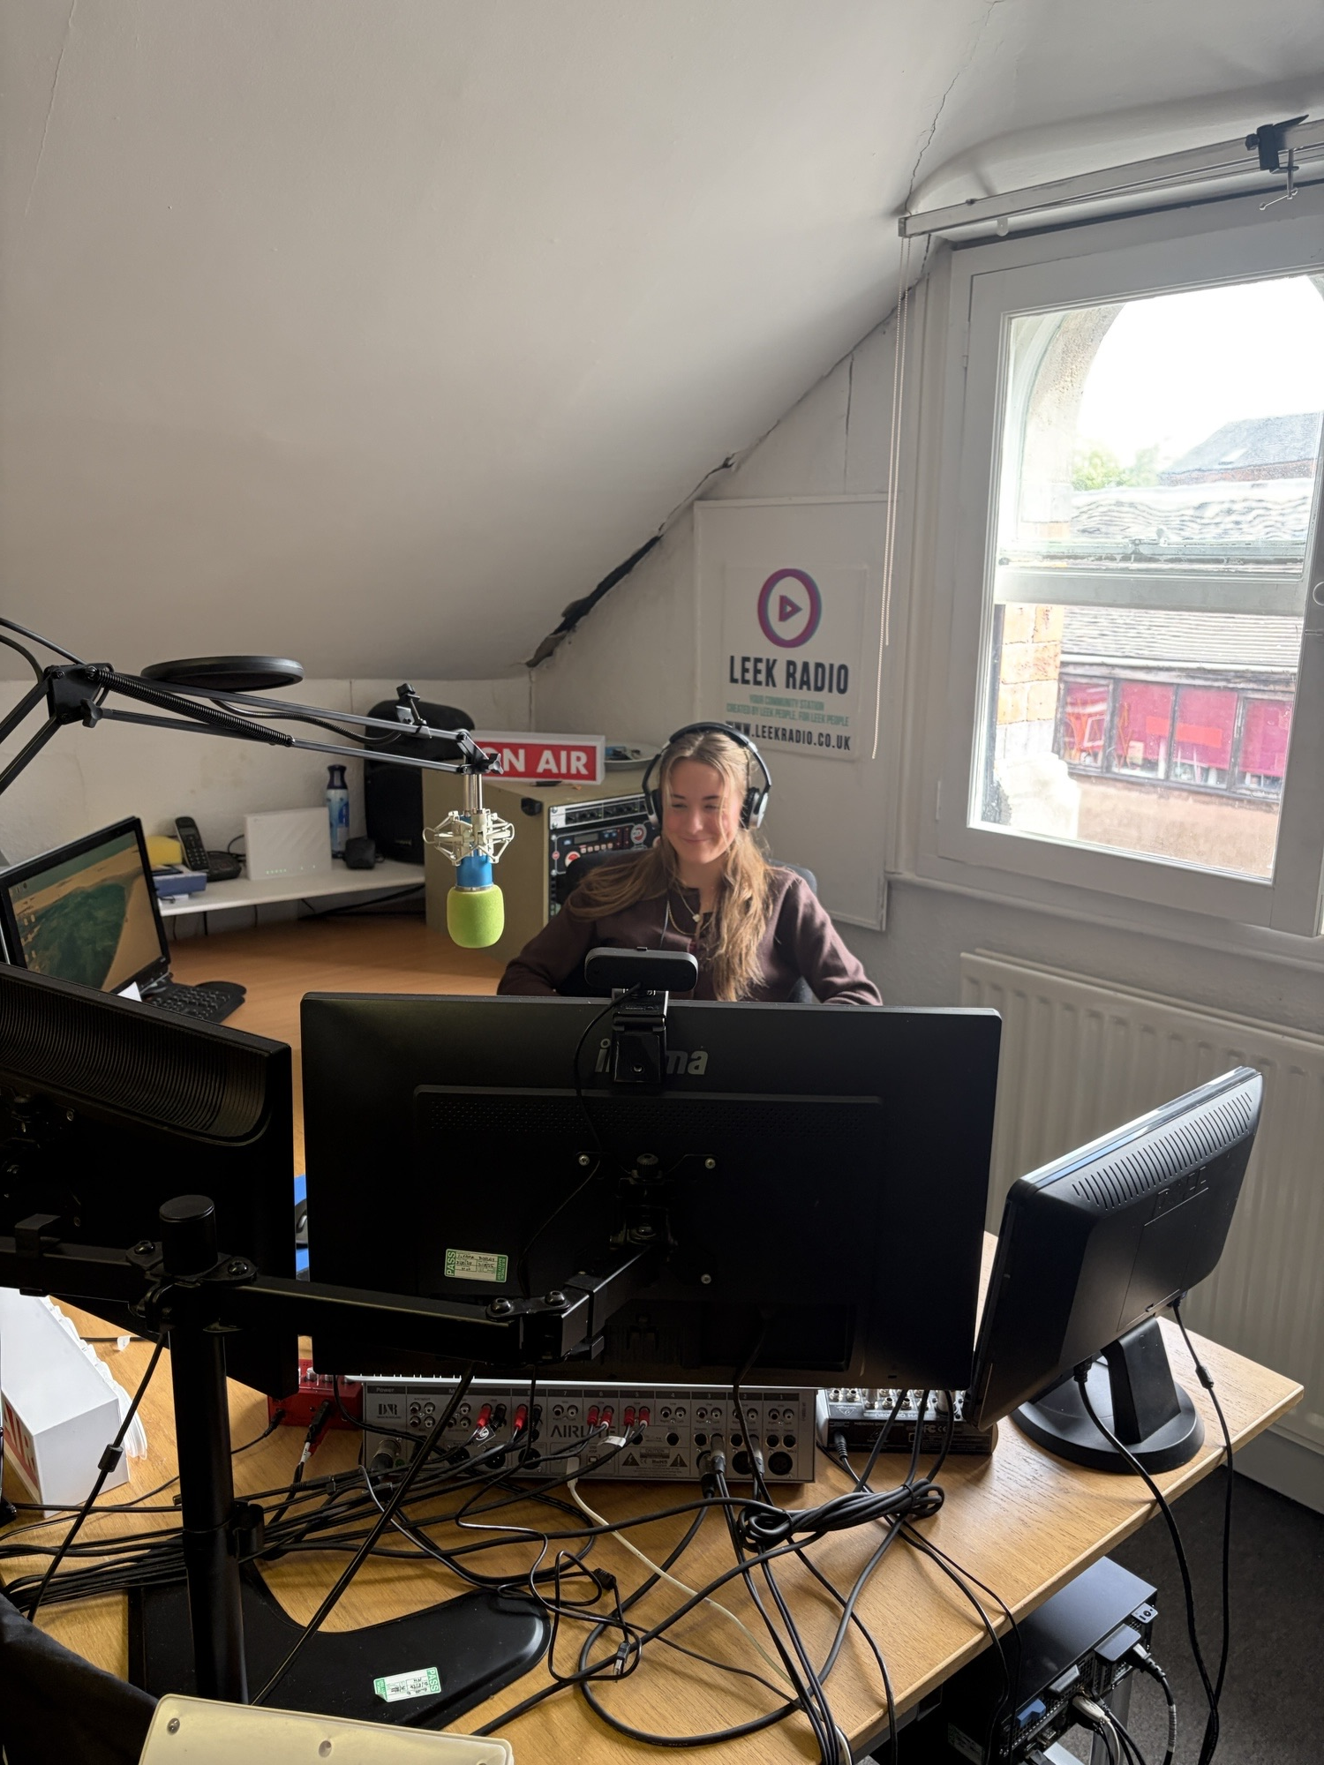
Photo Montage

Slide 30
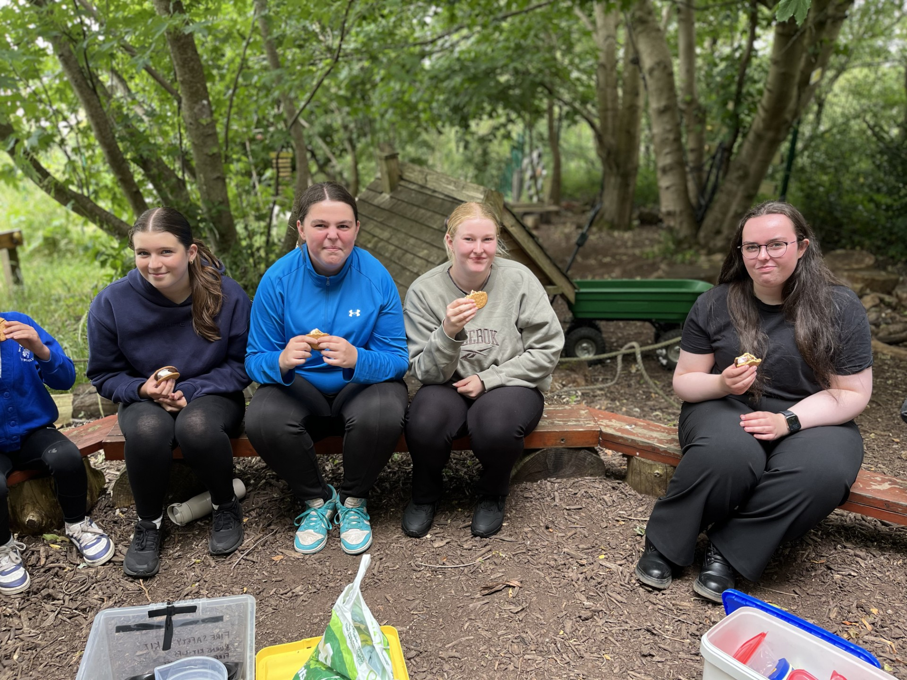
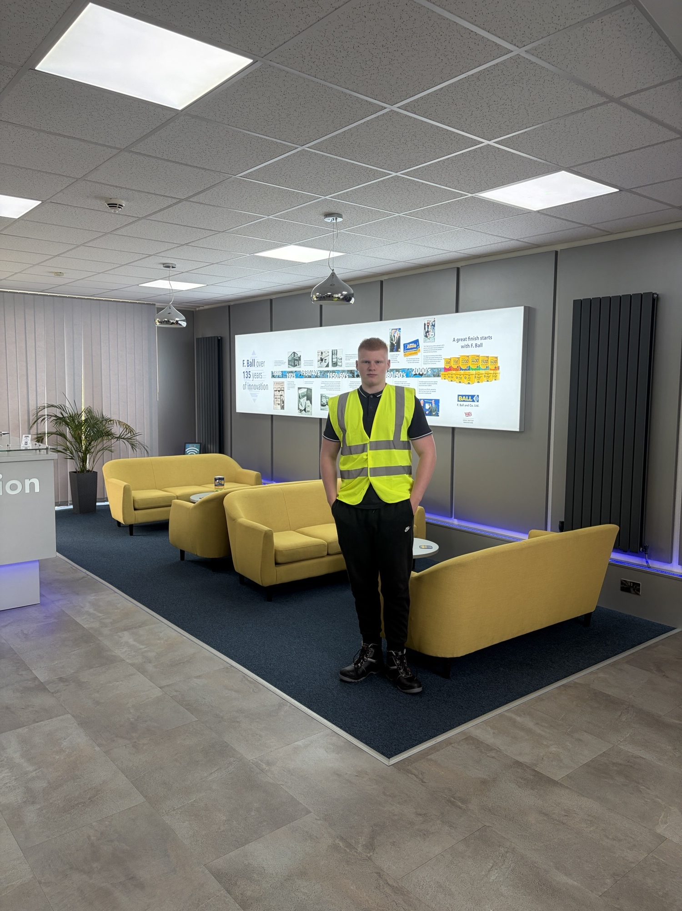
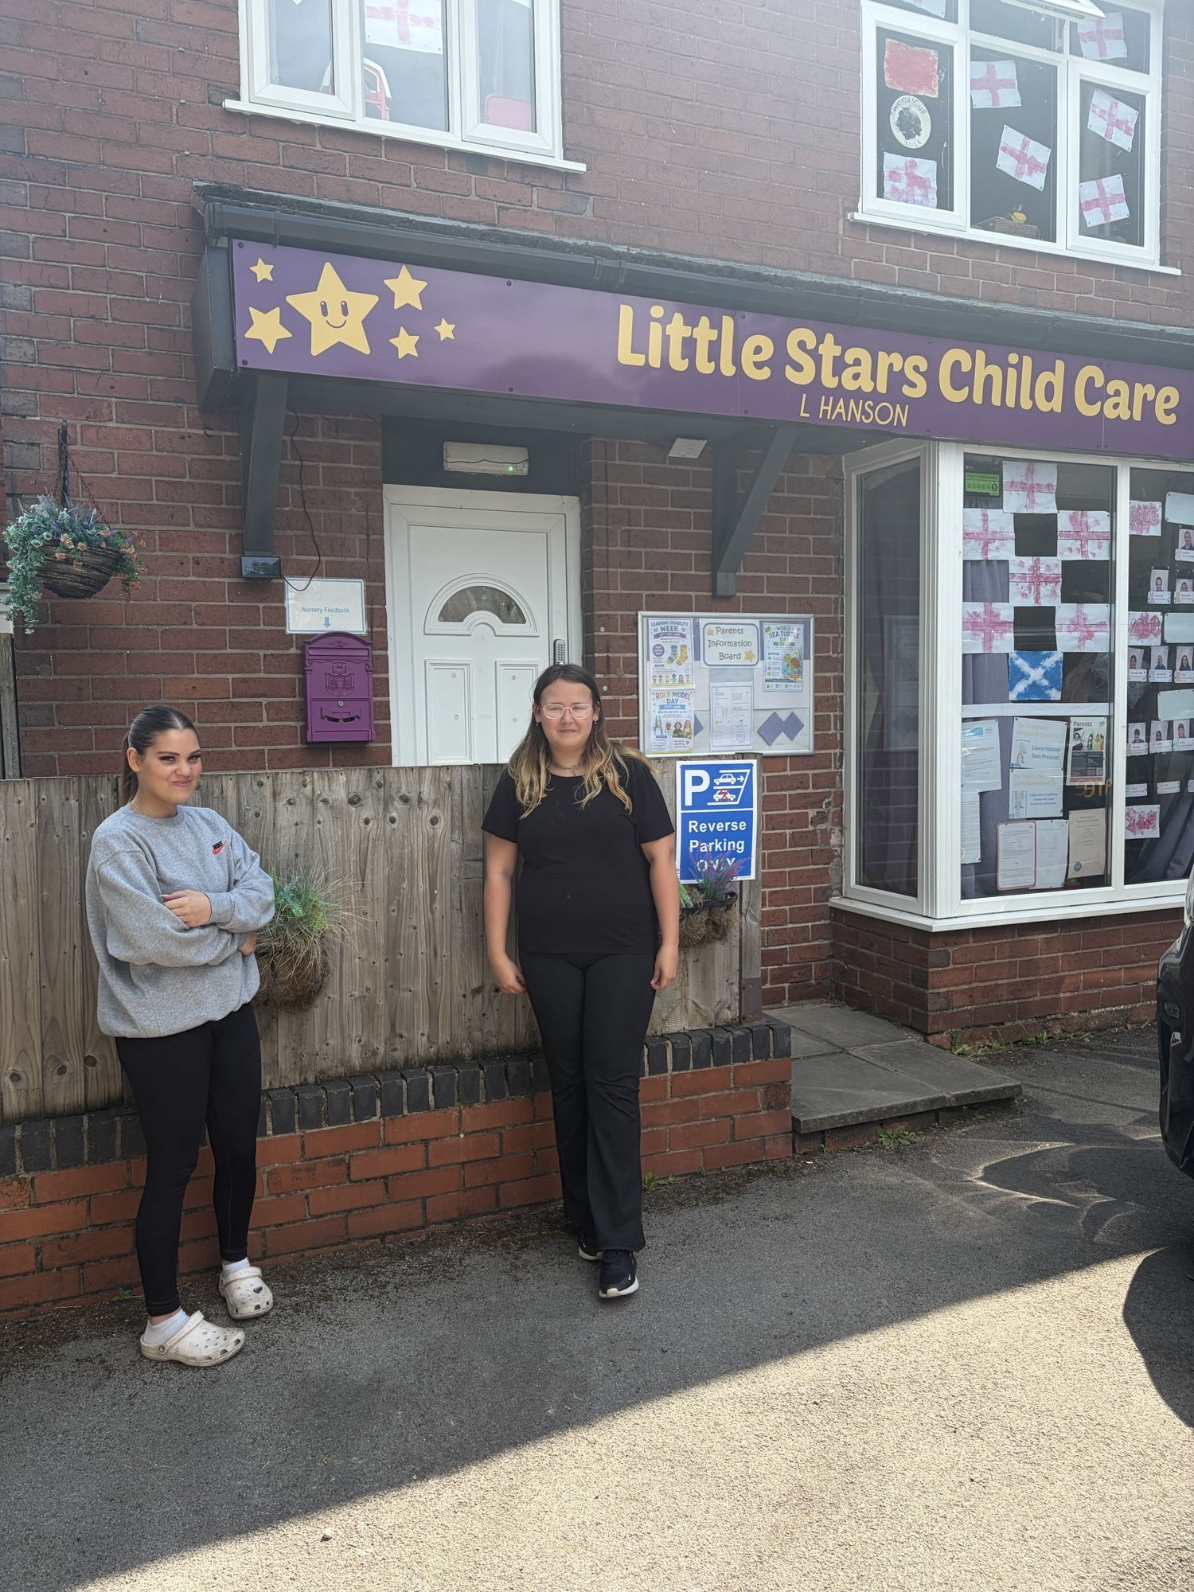
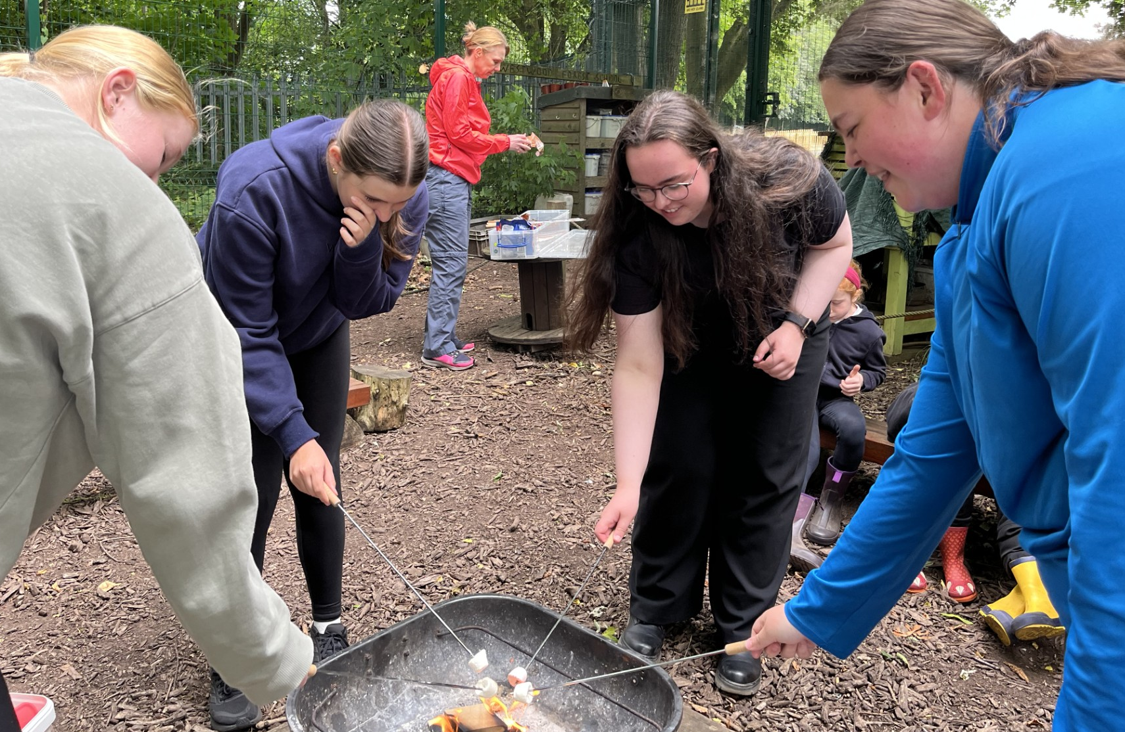
Photo Montage

Slide 31
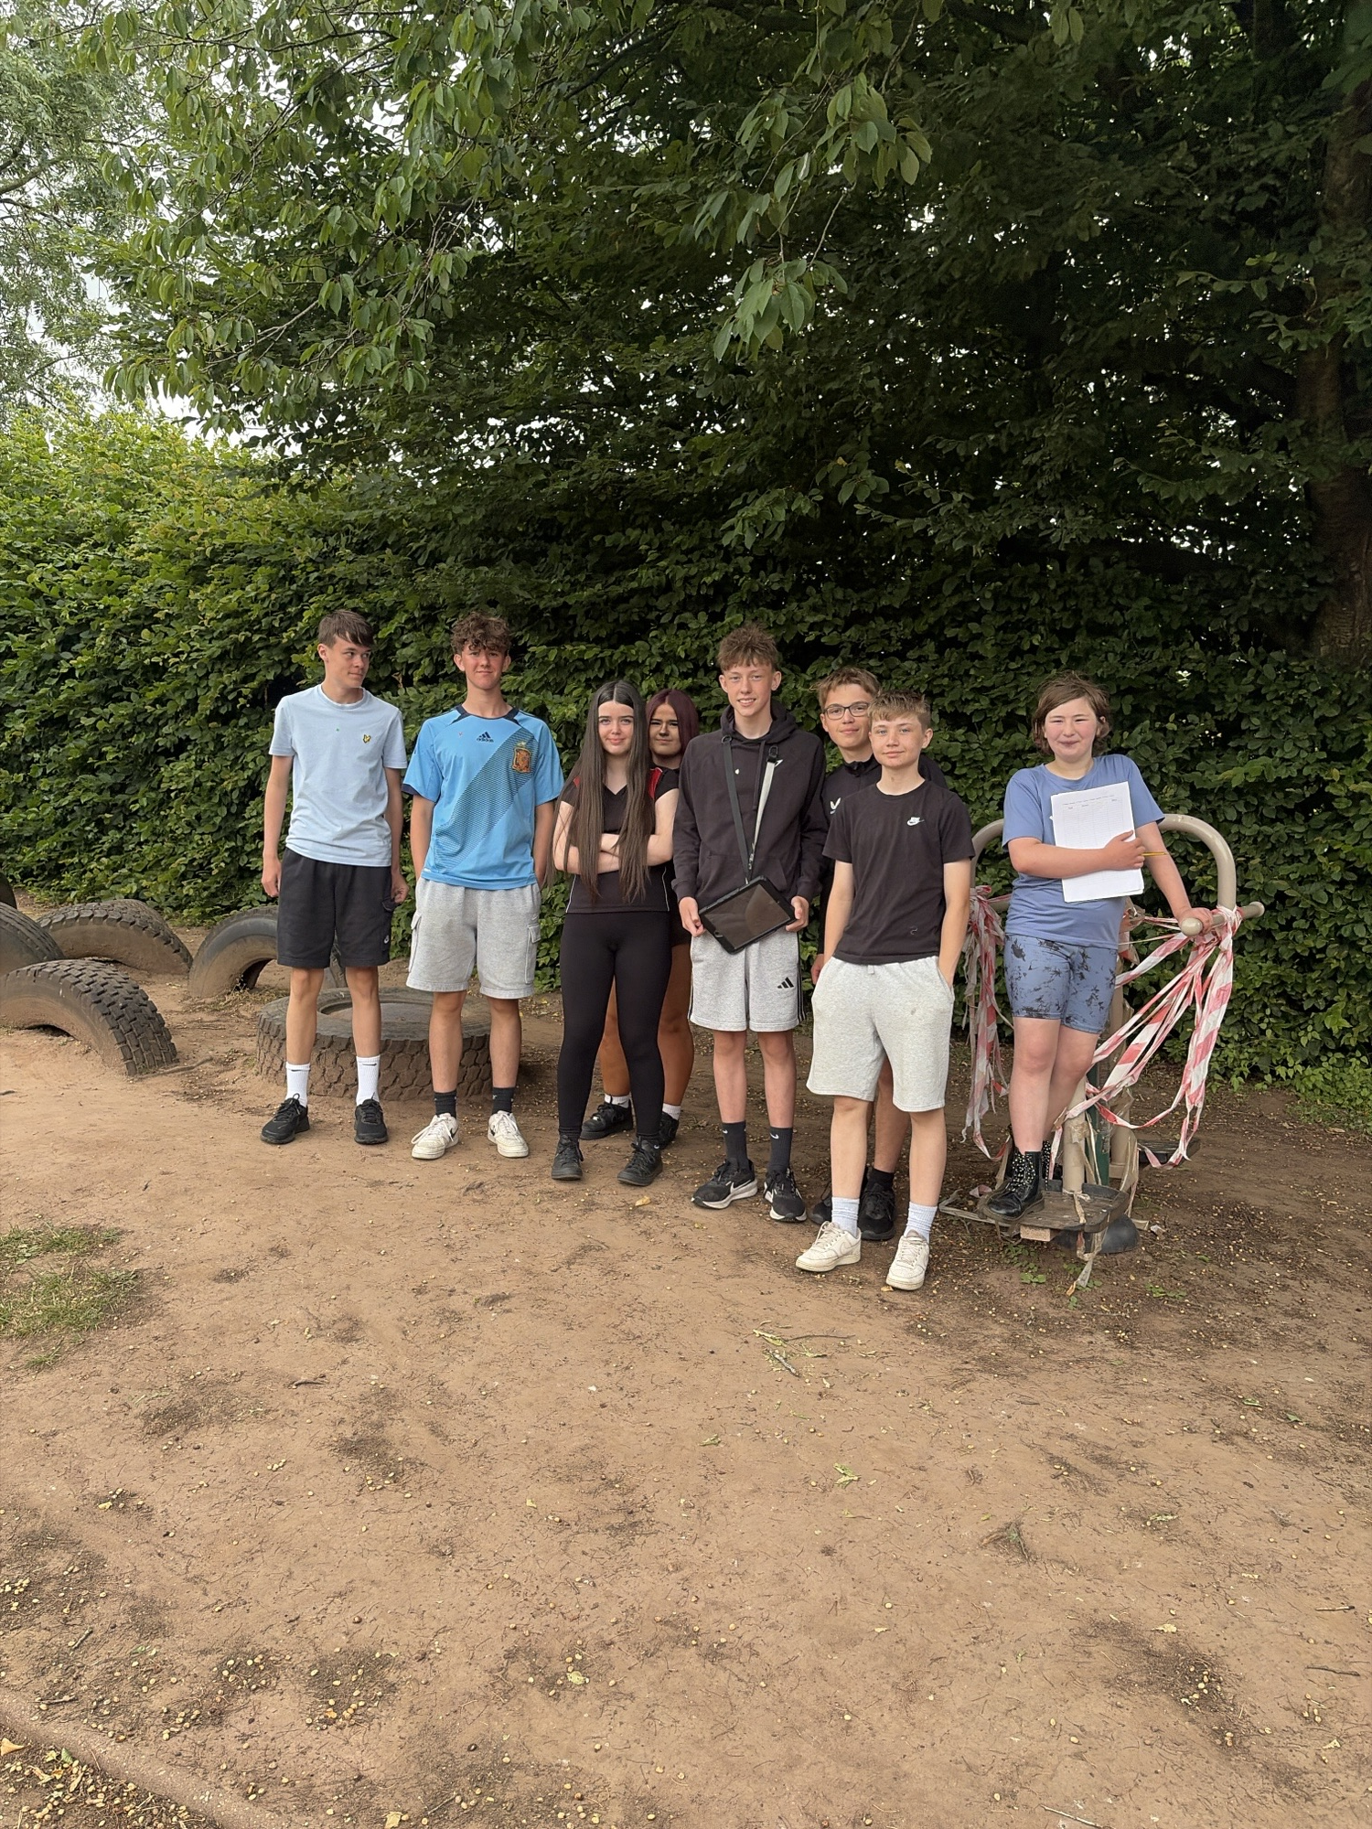
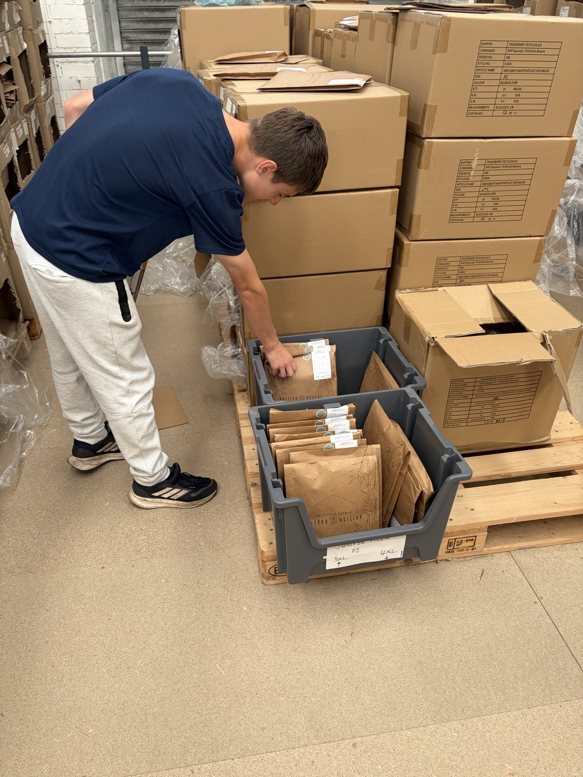
Photo Montage

Slide 32
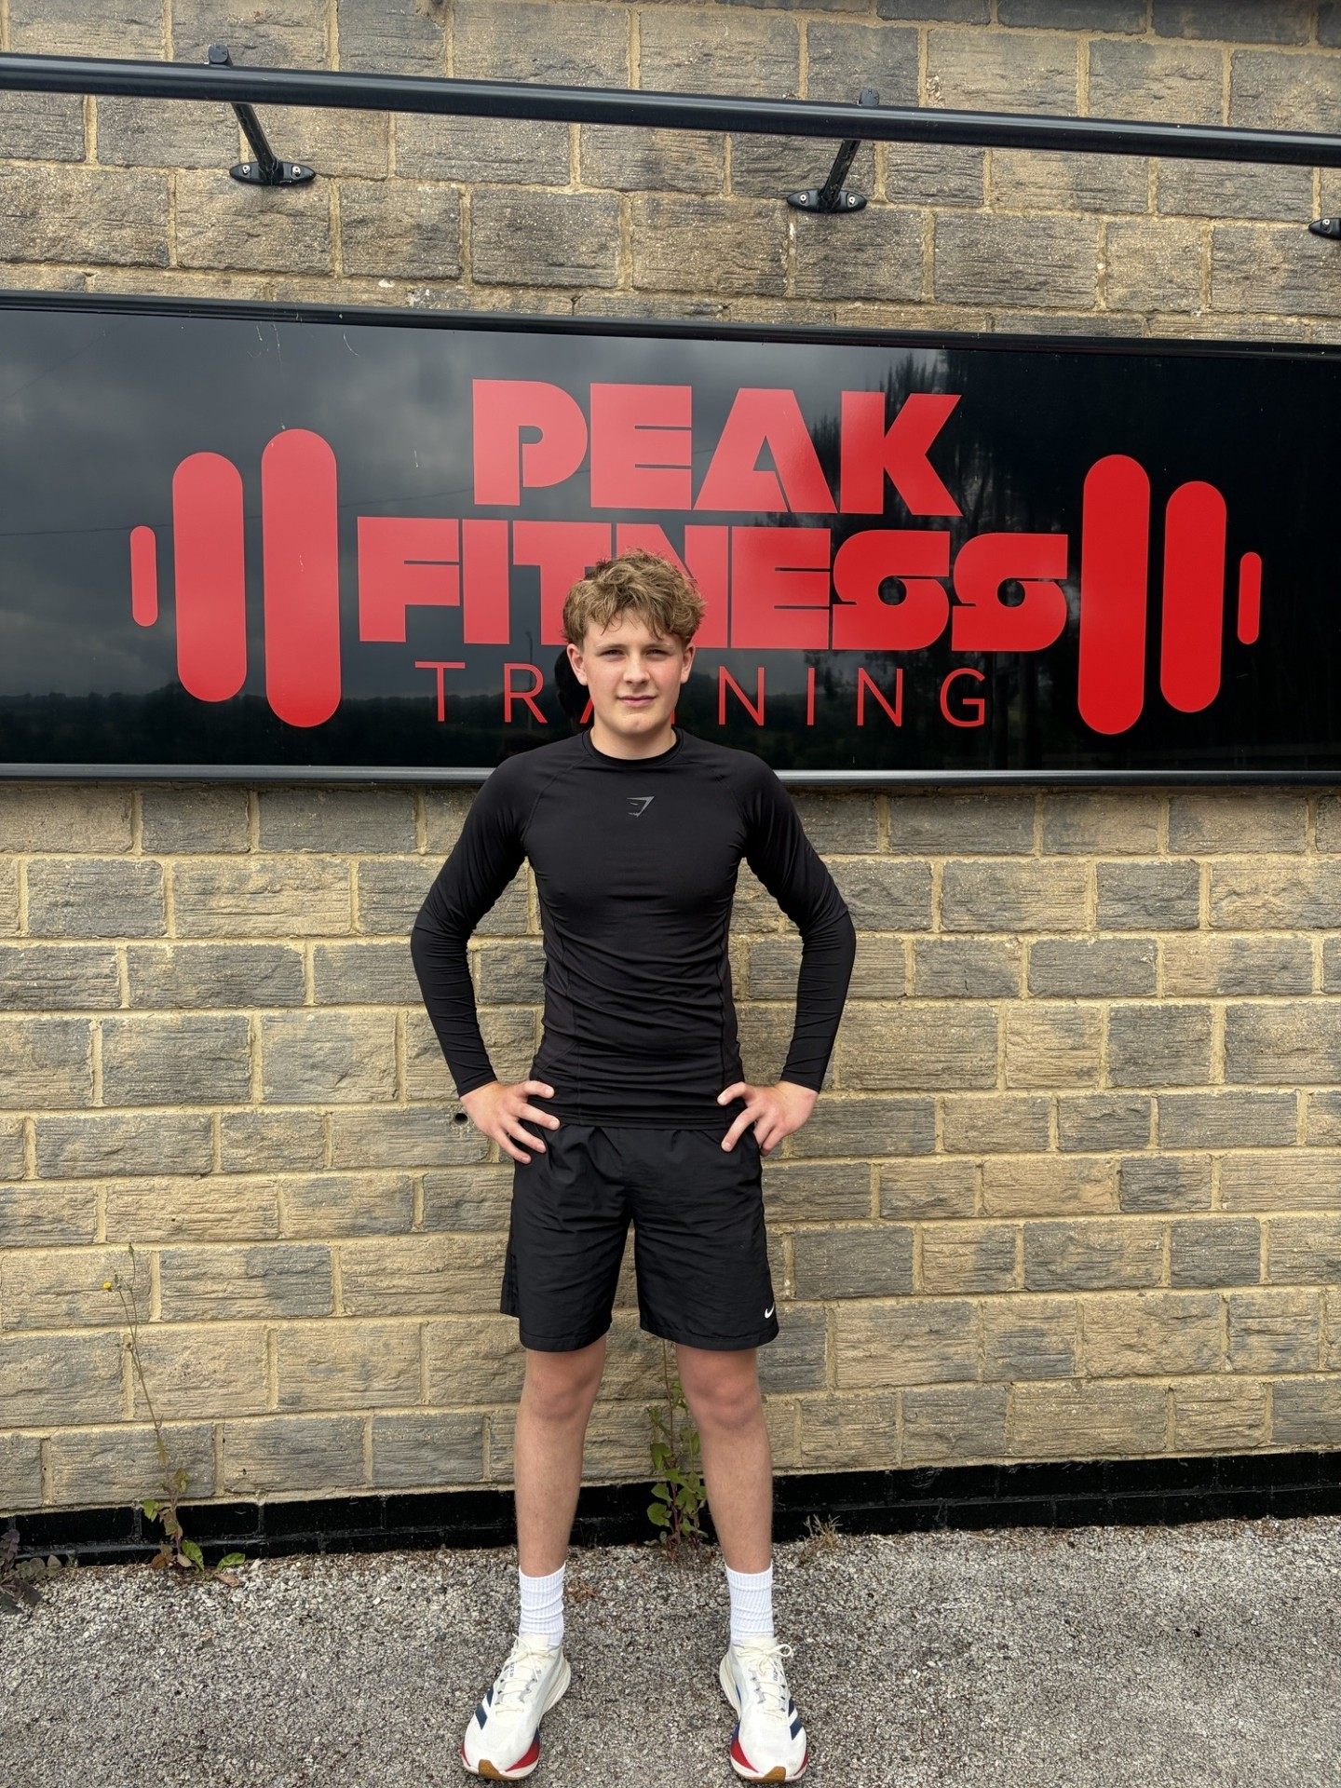
Photo Montage

Slide 33
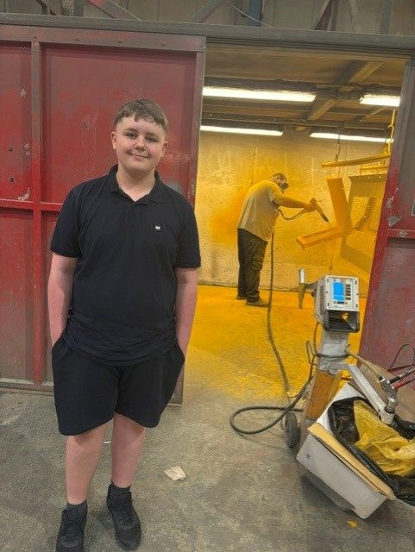
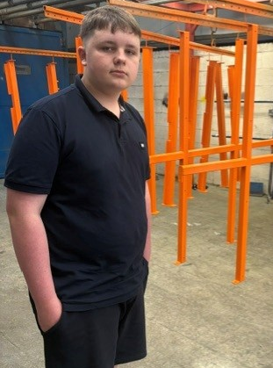
Photo Montage

